Slide 1
T-Mobile TechX Internship
Presented by: Rayyan Hussain
Faculty Advisor: Min Chen

Slide 2
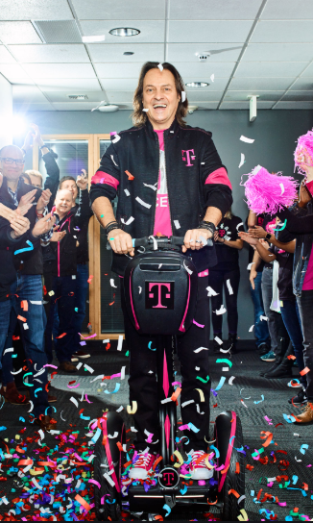
T-Mobile??
T-Mobile US, Inc. was founded in 1994 as ‘VoiceStream’
Currently the third largest wireless carrier in the US
Main product: Wireless services for both consumer and business customers
Coolest CEO

Slide 3
My Team + Role
Contact Center Technologies Design Team (CCT)
Team creates and enables solutions for T-Mobile contact centers to receive, place, schedule, route and deliver customer calls to the appropriate representatives
Based on Team of Experts model
My Role: Software Engineer
Supporting CCT Design team with data management, analytics/reporting, and full stack software development

Slide 4
Internship Project

Slide 5
Project Overview
Project Functionality
Develop a web based tool that will manage T-Mobile’s toll free numbers (TFN)
Full stack application that utilizes SQL Server, C#, TypeScript, and Angular
Goals
Ease process of managing database
More efficient and automated way of interacting with the TFN database
Enhance tracking and reporting for information within the DB
View all TFNs
Searching functionality
Insert TFN into database
Easy to use user interface

Slide 6
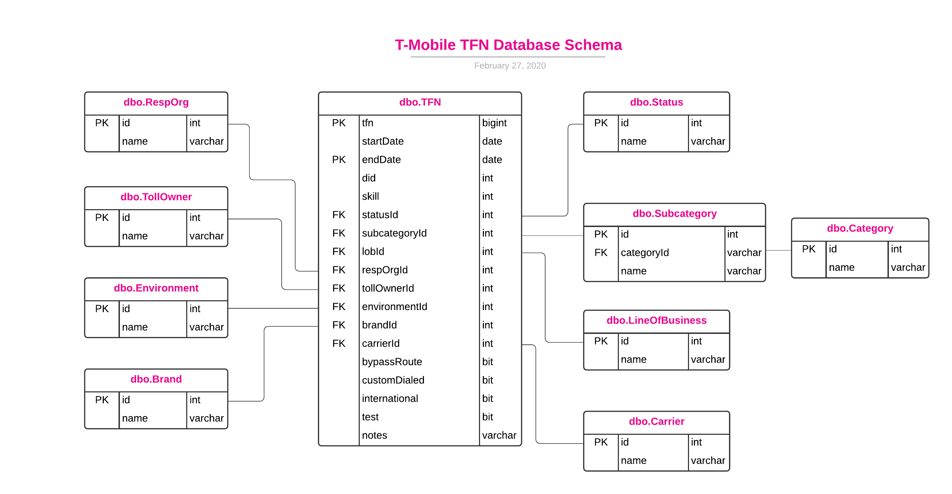
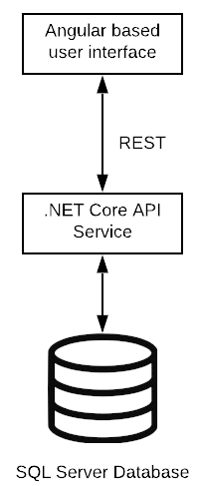
Project Design

Slide 7
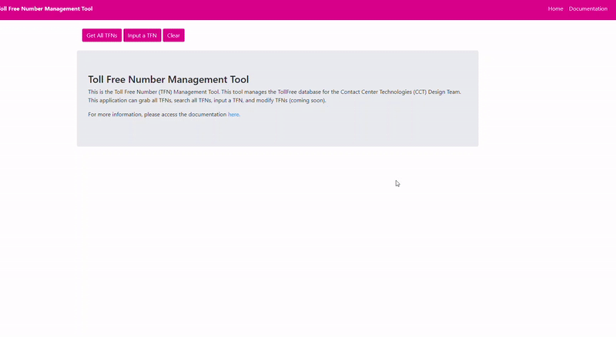
Functionality Demo

Slide 8
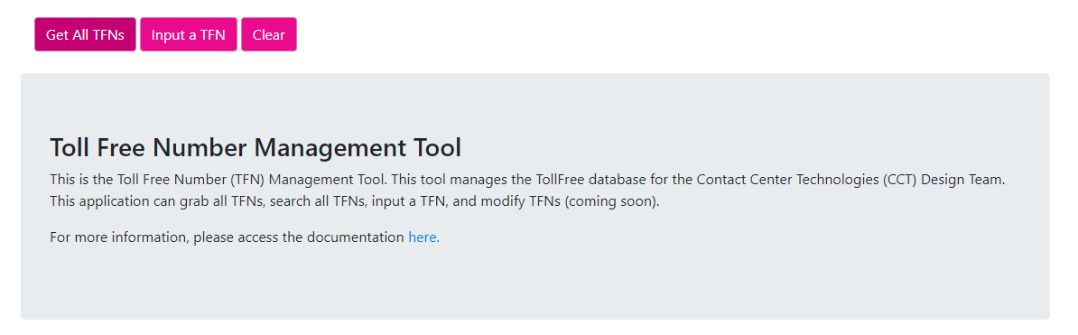

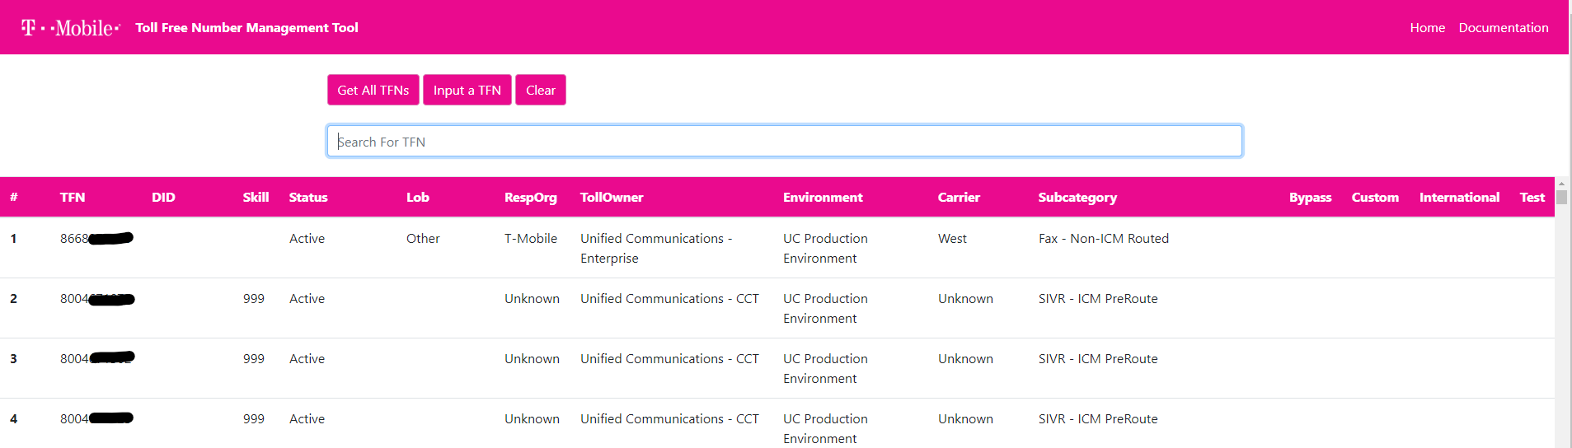

Slide 9
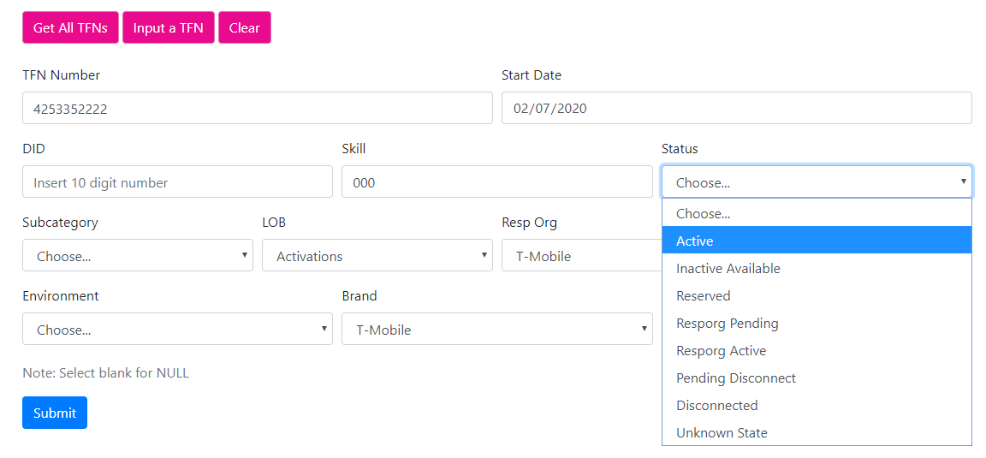

Slide 10
Accomplishments
Designed and deployed new TFN database in SQL Server
Migrated data from string based data in Microsoft Access to normalized database in SQL Server
- Utilized C# to interface with database and bulk import data into SQL Server
Developed Angular front end
- Utilized TypeScript and Angular to build UI
- Real time search functionality added

Slide 11

What have I learned?
Experienced working in a fast, agile, and team based environment
Learned the general architecture behind a full stack application
Improved my skills in writing code and working as a software engineer
Learned new languages and how they integrate with applications
Developed skills in C#
Angular
TypeScript

Slide 12
Useful Coursework
CSS 360 – Software Engineering
Agile methodologies
CSS 370 – Analysis and Design
Software design and diagramming
CSS 475 – Database Systems
Database management
CSS 342, 343 – Data Structures and Algorithms
General programming techniques

Slide 13
Shoutouts
T-Mobile and the CCT Design Team
Caryn Charpier
Alex Rogers
Avi Mizrahi
Faculty Advisor
Min Chen
CSS department and instructors

